Slide 1

Introduction to Personality
Personality and leadership
Dr. Mary Kinahan

Slide 2
Learning Outcomes
1. Introduce you to Personality Theories
2. Personality and Psychometrics
3. Exploring your interpersonal differences through MBTI and IPIP Big Five

Slide 3

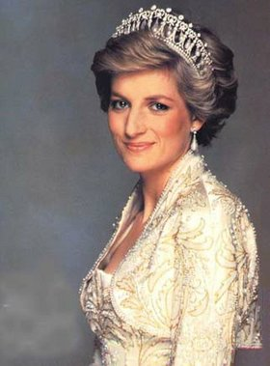
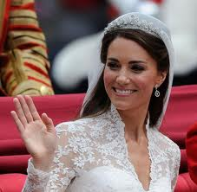
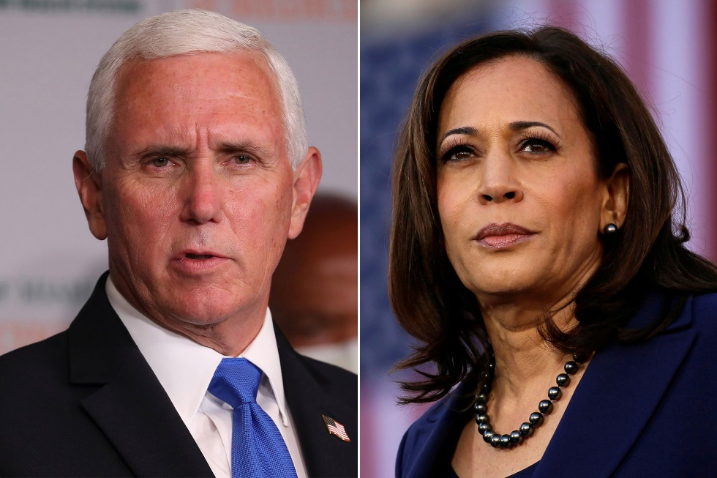

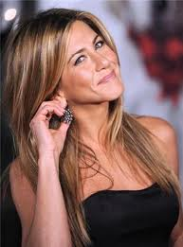
Individual Differences
Notes:
3

Slide 4
PERSONALITY - KEY QUESTIONS
What are the elements that make up a person's personality?
How should we best describe the whole person?
Are people consistent, or do they change over time and between different situations?
What are the key influences on personality?
How can we help people to “improve” their personalities?

Slide 5
Nature vs. Nurture
as alternative determinants of personality
Either Nature or Nurture as alternative explanations for personality differences
Genetic influences
(Heredity)
Environmental
influences
Family
Society, Community & Culture
Experience
Personality

Slide 6
Nature and Nurture as independent
determinants of personality
Genetic influences
(Heredity)
Environmental
influences
Family
Society, Community & Culture
Experience
Personality

Slide 7
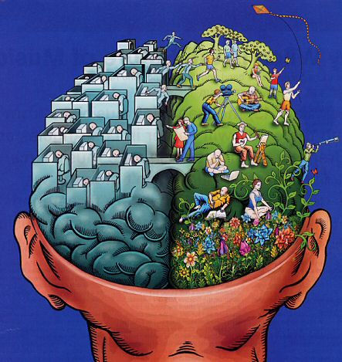
DETERMINANTS OF PERSONALITY
Genetic and situational factors influence behaviour patterns
Disagree over:
Emphasis to be given to these factors
How they should be measured
How they interact
Notes:
However, in general psychologist nowadays agree that BOTH genetic and situational factors influence behavior.

Slide 8
CONSEQUENCES OF DEBATE
Manager 1
People
development is
a waste of time
Nature
Can invest in
people
Manager 2
Nurture

Slide 9
WHAT IS PERSONALITY?
Personality refers to the enduring characteristics and behavior that comprise a person’s unique adjustment to life, including major traits, interests, drives, values, self-concept, abilities, and emotional patterns. Various theories explain the structure and development of personality in different ways, but all agree that personality helps determine behavior.
The field of personality psychology studies the nature and definition of personality as well as its development, structure and trait constructs, dynamic processes, variations (with emphasis on enduring and stable individual differences), and maladaptive forms.
Adapted from the APA Dictionary of Psychology

Slide 10
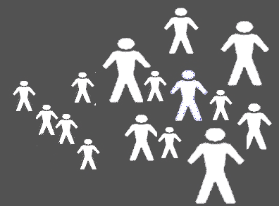
Why does it matter
… why employees act the way they do
…why they have favorable or unfavorable attitudes towards their jobs
…as the assessment of personality (psychometrics) can be the basis for organizational decisions
Personality has been shown to influence:
Career choice
Job satisfaction
Stress
Leadership
Job performance

Slide 11

Trait approach
Majority of personality research (Cattell, Eysenck, Costa & McCae)
Trait theory attempts to measure individual personality differences in order to understand people’s differences and similarities
Trait is a theoretical unit that indicates characteristics e.g., shyness, a group of traits (shyness, quiet etc.) make up a type e.g., introvert
Trait theory assumes that type of trait is stable and enduring over time (research shows this might not be the case)
Identifies major patterns of behaviour in which individuals differ and classifies them.
Most useful theory for Organisational Psychology! Widely used approach for psychometrics

Slide 12

You Fit a Type, You Have a Trait.

Slide 13
TYPES AND TRAITS
Categorize people into personality types
… a personality type is a distinct
label for a distinct pattern of
personality characteristics

Slide 14
TYPES AND TRAITS
Trait is any enduring behaviour that occurs in a variety of settings
Examples of traits include shyness
excitability, reliability, moodiness
Notes:
Hippocrates (The father of medicine) – first personality theorist, lived in Greece around 400 BC. He claimed that personality type or temperament was determined by bodily humours, generating the different behaviour patterns. For example, a person with black bile would show behaviors such as being depressed, sad, etc. and therefore called melancolic type. A person with yellow bile would be aggressive excitable, irritable, etc. and called coleric.

Slide 15
ARE YOU A TYPE A OR B PERSONALITY?
Objective:
To give you an opportunity to assess your personality of propensity to suffer stress-related disease
Instructions:
This questionnaire is designed to identify whether you have a Type a or B personality.
Here are eight pairs of statements describing aspect of personality and behaviour.
For each pair, decide which is more accurate as a description of you and circle the appropriate point on the seven-point rating scale
Be Honest – no right or wrong answers

Slide 16
CHAPTER EXERCISE
I am casual about appointments | 1 | 2 | 3 | 4 | 5 | 6 | 7 | I am never late
I am not competitive | 1 | 2 | 3 | 4 | 5 | 6 | 7 | I am very competitive
I never feel rushed, even under pressure | 1 | 2 | 3 | 4 | 5 | 6 | 7 | I always feel short of time
I take things one at a time | 1 | 2 | 3 | 4 | 5 | 6 | 7 | I try to do too many things at once

Slide 17
I have many interests | 1 | 2 | 3 | 4 | 5 | 6 | 7 | I have few interests outside work
I concentrate on finishing what I am doing right now | 1 | 2 | 3 | 4 | 5 | 6 | 7 | I am always thinking about what I am going to do next
I take my time, do things slowly | 1 | 2 | 3 | 4 | 5 | 6 | 7 | I do things, even walking and eating, fast
I like to express my feelings | 1 | 2 | 3 | 4 | 5 | 6 | 7 | I prefer to keep my feelings private

Slide 18
Interpretation
When you are finished, calculate your score by totaling the
Numbers you have circled and multiplying that by three
Write down you final score.
Less than 50 = B
50 – 89 = B+
90 – 119 = A-
120 – 145 = A
More than 145 = A+

Slide 19
PERSONALITY TYPES A AND B
A
B
Characteristics
Competitive
High need for achievement
Impatient
Restless
Characteristics
Easy going
Works at a steady pace
Relaxed
Moves and speaks slowly
Notes:
Friedman and Rosenman identified two extreme behaviour syndromes which explained differences in stress levels. Specifically, the found that Type A personalities were 3x more likely to suffer heart disease than Type B personalities.
The typical Type A thrives on long hours, large amounts of work and tight deadlines. These are socially and organizationally desirable characteristics, as are competitiveness anda high need for achievement. However, if you are an extreme Type A person than you may not be able to relax long enough to stand back from a complex problem to make an effective and comprehensive analysis and may lack the patience and relaxed style required in some management positions. Impatience and hostility of type A people can increase the stress levels of persons you work with.

Slide 20
TYPES AND TRAITS
Carl Gustav Jung
1875-1961
Psychological pressures for extraversion or introversion
thinking
NT
ST
practical
conceptual
sensation
intuition
gregarious
creative
SF
NF
feeling
Huczynski & Buchanan, Organizational Behaviour 6e, © Pearson Education 2007
Notes:
Carl Gustav Jung – Swiss Psychologist
His approach is based on psychological preferences for extraversion or introversion, for sensation or intuition, for thinking or feeling and for judging or perceiving.
At the heart of his complex theory lie four personality types, plotted across the sensation-intuition and thinking-feeling dimensions.

Slide 21
TYPES AND TRAITS
Jung’s personality types
TYPE | CHARACTERSTICS
Sensation-Thinking (ST) | Pratical, down to earth, impersonal, interested in facts, wants order, precision, no ambiguity, etc.
Intuition-Thinking (NT) | Conceptual and inventive, sees future possibilities through analysis, is comfortable using flow charts, etc.
Sensation-Feeling (SF) | Gregarious and sociable, interested in facts about people, dislikes ambiguity, has not time for reflection, etc.
Intuition-Feeling (NF) | Creative, values imagination and warmth, is enthusiatic, has grandiose goals, dislikes rules, etc.
Sensation-Thinking (ST)
Intuition-Thinking (NT)
Sensation-Feeling (SF)
Intuition-Feeling (NF)
Huczynski & Buchanan, Organizational Behaviour 6e, © Pearson Education 2007

Slide 22
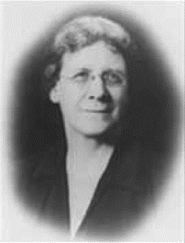
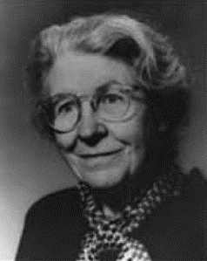
TYPES AND TRAITS
Myers-Briggs
Myers-Briggs Type Indicator
Based on Jung’s approach
Most-popular personality assessment
16 types
Katherine Cook Briggs Isabel Briggs Myers
(1875-1968) (1997-1980)
Introvert
Extravert
Sensing
iNtuition
Thinking
Feeling
Judging
Perceiving
Huczynski & Buchanan, Organizational Behaviour 6e, © Pearson Education 2007
Notes:
Using this theory, the mother and daughter team of Katherine Briggs and Isabel Myers developed the Myer-Briggs –Type Indicator
The world’s most popular personality assessment, used in a wide range of organizational contexts, including management development programmes focusing on self-awareness and personal development.
The MBTI makes Jung’s theory acsessible and practical, rating personal preferences on the four scales:
If you are an ENFP, you have been types as extravert, intuitive, feeling, and perceiving.
Application: for example, problem-solving and decision-making groups need a complementary personality mix, intuitive types need sensing types, feeling types need thinking types. Effective teamworking as proposed by Meredith Belbin (GROUP STRUCTURE)

Slide 23
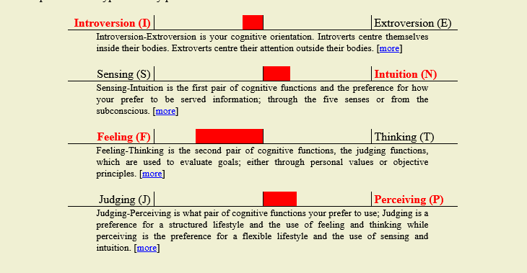

Test Yourself
Click the following link for Jungian (MBTI-type) Personality Questionnaire
http://openpsychometrics.org/tests/OEJTS/
Take note of your types (screenshot)

Slide 24
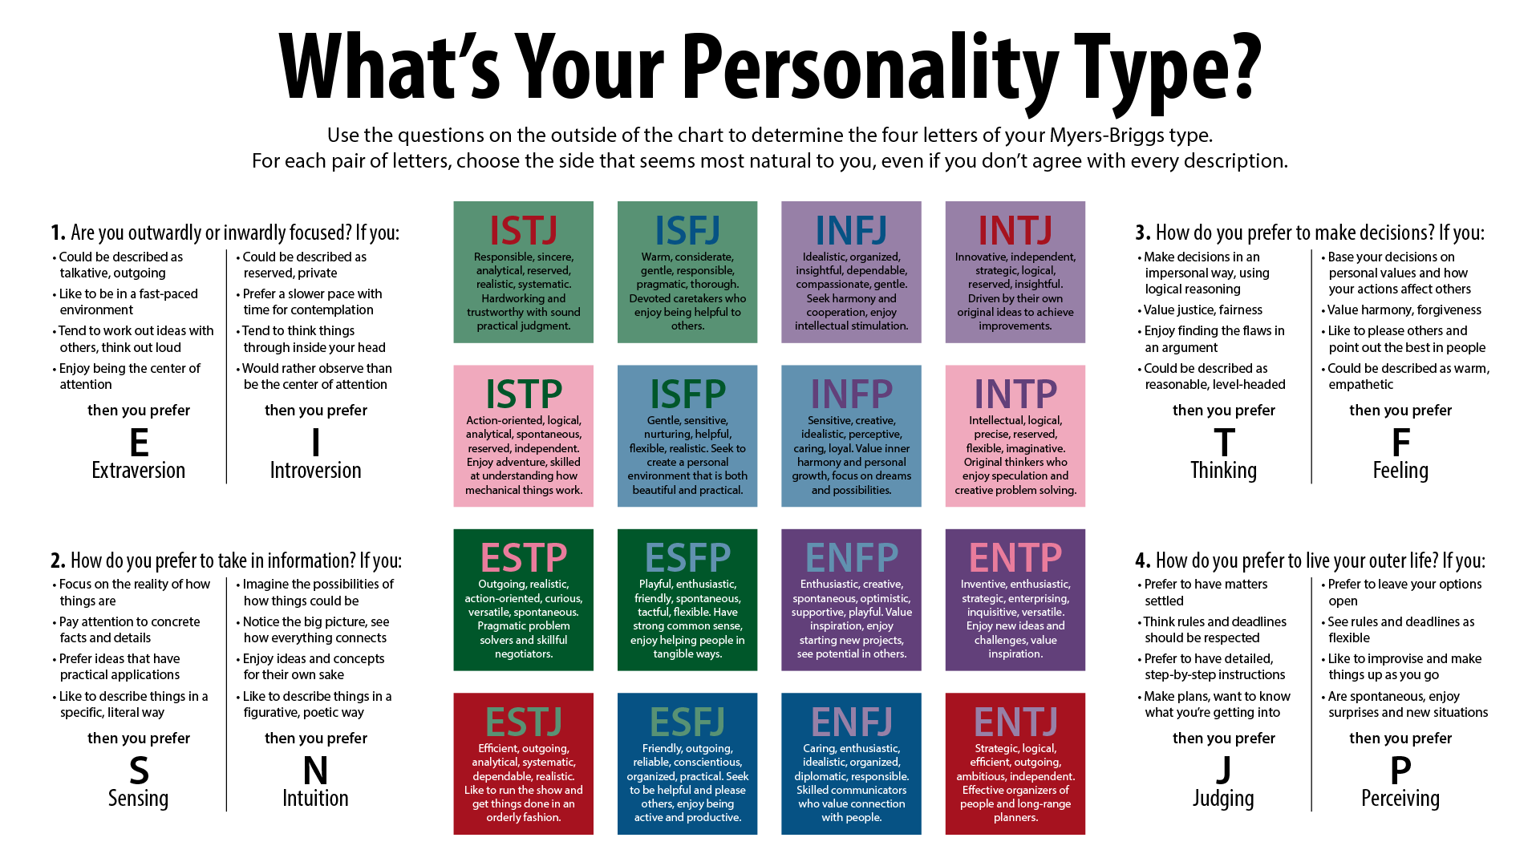

Slide 25
Decision Time
You are hiring someone for a job. One candidate has a perfect resume and interview. The other candidate was not as outstanding as the first, however, the second candidate is a single parent who really needs the job and is particularly passionate about working in your company. You can only hire one person.
Who do you hire and why?
What did you decide?
What do you see as the difference between the two preferences?
What do you think are the differences between thinking and feeling?
Where do you this this is relevant in your working lives?

Slide 26
T/F: It’s all about how we approach decisions
How would you decide which car to buy?
OR
You've been looking at several houses to buy and must make a decision - what do you think about first and second as you walk into each house? What sways your decision?
Remember, this is about preference, not ability

Slide 27
Criticism of MBTI
MBTi has been used in a variety of organisational settings.
Taken by 2.5 million people per year and 89 of Fortune 100 companies use it.
Evidence is mixed on validity as measure of personality – but MOST are against it.
“Next time, just look at the horoscope. It is just as valid and takes less time” (Ariely, 2014, p.12)
ONE Main problems – forces a person into one type or another – what happens if you’re ambivert (both/neither E or I) - Binary, and overly positive
Difficulty of interpretation

Slide 28
Criticism of MBTI
MBTI has been found to be unrelated to job performance!!
Useful for self-awareness and career guidance, but as it tends to be unrelated to job performance, managers consider using the BIG 5 as personality selection test for job candidates
Unlike BIG 5 (Next), MBTI/ Jungian types are based on theory, no empirical findings, no evidence.
Distinction between using personality tests for (a) description or (b) prediction.
Summary: MBTI describes, raises self-awareness, helps development, aligns with big 5, but mixed to little evidence it links to performance

Slide 29

MBTI and Leadership
Despite criticism – widely used for Leadership development purposes e.g., career development, self-awareness, leadership academies etc.
E.g., Jetblue
Wide range of studies and research examining MBTI and Leadership.
No strong evidence for particular ideal MBTI for leadership effectiveness
– depends on followers, situations etc. so best a reflective tool for self-development

Slide 30
MBTI and Big 5
McCrae and Costa (1989) found that the MBTI scales are closely related to the five-factor model.
They found that Extraversion on the
MBTI was correlated with the Extraversion factor, Intuition was related to Openness to
Experience, Feeling was correlated with Agreeableness, and Judging was related to
Conscientiousness.
McCrae and Costa, however, found no relationship between the MBTI scales and Neuroticism.
BUT Big 5 is empirical prove, MBTI is theoretical.

Slide 31
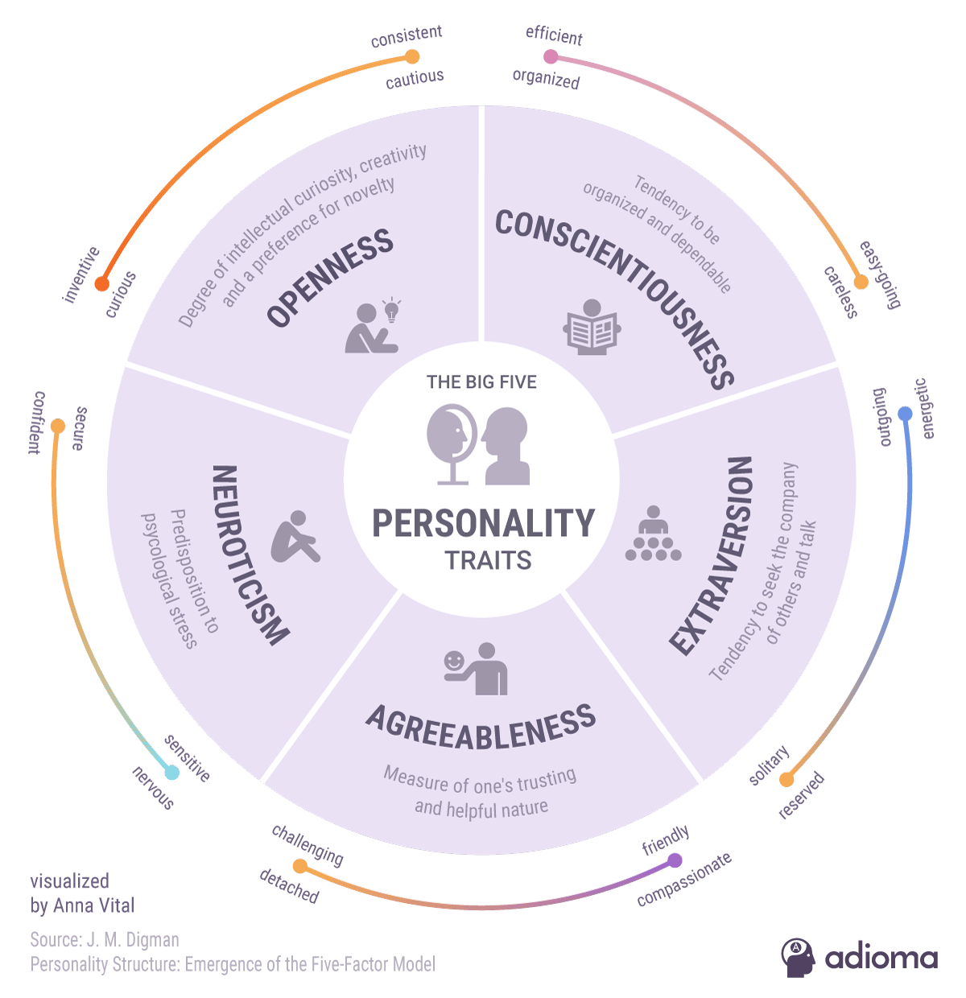
Big FIVE Personality Model

Slide 32
BIG 5 PERSONALITY FACTORS/ TRAIT CLUSTERS
Eysenck – Two Factor – Stability vs. E/I
Search for trait clusters has culminated in what are known as big 5 personality clusters
Not personality types
Set of factors or super traits
Each is made of Facets!
Notes:
How many personality traits can you list? Would you believe 17.953? That’s the number of personality-related words found in a search of an English language dictionary in a study conducted over 60 years ago. These traits were reduced using a statistical technique called factor analysis to five different personality factors.
These dimensions are very important and they are related strongly to work performance. This is the case across many different occupational groups (e.g., police, managers, salespersons) and several kinds of performance measures (e.g., ratings of individuals performance by mangers or others, performance during training programs, personnel records).

Slide 33

The Big 5 (OCEAN) (Costa & McCrae, 1990)
Extraversion – How ‘energetic’ one is
Agreeableness – One’s level of orientation towards other people
Conscientiousness – How ‘structured’ one is
Neuroticism – Tendency to Worry
Openness to Experience – Tendency to be speculative and Imaginative

Slide 34
The “Big Five” – Costa & McCrae
Five Dimensions of Personality
FACTOR | CHARACTERSTICS
Conscientiousness | Responsible, prudent, self-control, persistent, planful, achievement oriented __I keep my room neat and clean (Item example).
Extraversion | Sociable, assertive, talkative, ambitious, energetic __I like lots of excitement in my life.
Agreeableness | Good natured, cooperative, trusting, likeable, friendly __People never think I am cold and sly.
Emotional Stability | Secure, calm, low anxiety, low emotionality __I usually feel sad or „down“.
Openness to experience | Curious, intelligent, imaginative, independent __I enjoy the challenge of change.
Notes:
34

Slide 35
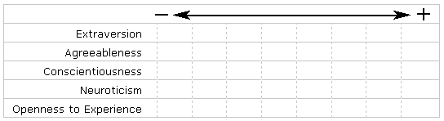
The Big 5 (OCEAN) (Costa & McCrae, 1990)
None of the five traits is in themselves positive or negative, they are simply characteristics that individuals exhibit to a greater or lesser extent.

Slide 36
FACTOR 1 – OPENNESS
Traits belonging to openness runs on a continuum from “explorer”, at one extreme, to “preserver” at the other
Explorer
Creative,
open-minded
intellectual
Preserver
unimaginative
disinterested,
narrow-minded

Slide 37
FACTOR 1 – OPENNESS
Explorer traits are useful for entrepreneurs, architects, change agents
Preserver traits are useful for finance managers, scientists

Slide 38
FACTOR 2 – CONSCIENTIOUSNESS
Traits belonging to conscientiousness runs on a continuum from “focused”, at one extreme, to “flexible” at the other
Focused
Dutiful,
Achievement orientated
Self-disciplined
Flexible
frivolous
irresponsible
disorganized

Slide 39
FACTOR 3 – EXTRAVERSION
Traits belonging to extraversion runs on a continuum from “extravert”, at one extreme, to “introvert” at the other
Extravert
Warm
positive
Introvert
Reserved
Shy

Slide 40
FACTOR 4 – AGREEABLENESS
Traits belonging to agreeableness runs on a continuum from “adapter”, at one extreme, to “challenger” at the other
Adapter
Straightforward,
compliant
sympathetic
Challenger
Quarrelsome
unfeeling

Slide 41
FACTOR 5 – NEUROTICISM
Traits belonging to neuroticism runs on a continuum from “reactive”, at one extreme, to “resilient” at the other
Reactive
Anxious
Depressed
Self-conscious
Resilient
Calm
Contented
Self-assured

Slide 42
The “Big Five” and Behaviour
Research indicated that there is relationship between the “Big Five” and job performance (Hurtz & Donovan, 2000; Salgado, 1997; 1998)
Individuals who are high on the conscientiousness, agreeableness, and emotional stability tend to have higher integrity, show higher employee reliability and were more attractive to managers who had hiring responsibilities (Dunn, 1993, Hogan & Hogan, 1989, Ones et al., 1993)
The Big Five are much more predictive of performance in jobs where the employee has a great deal of control than in jobs where the employee had little or no control (Barrick & Mount, 1993)
Movie A Beautiful Mind http://www.youtube.com/watch?v=aS_d0Ayjw4o
Notes:
42
These dimensions are very important and they are related strongly to work performance. This is the case across many different occupational groups (e.g., police, managers, salespersons) and several kinds of performance measures (e.g., ratings of individuals performance by mangers or others, performance during training programs, personnel records).
Think of an environment, you would have little opportunity to let your abitual way of responding appear in you behavior. Think of the opposite situation – a job where you had a good deal of control over your work habits. In the latter you could really be “you” and whether you performed well or poorly probably depended on how well your personality was suited to the job’s demands.
Problems can arive when an individual has plenty of g but lacks other attributes. The recent movie A beautiful mind tells the story of John Nash, a Nobel Prize winning mathematician who was brilliant (in a g sense) and high on achievement but who was severly impaired in social and interpersonal skills. Nash was emotionally unstable, eventually disintegrating into paranoia and delusional states. Early in his career he was favored because of his sheer brilliance and tenacity (conscientiousness, but his impairments in other dimensions eventually rendered him useless to the research facility where he was employed.

Slide 43
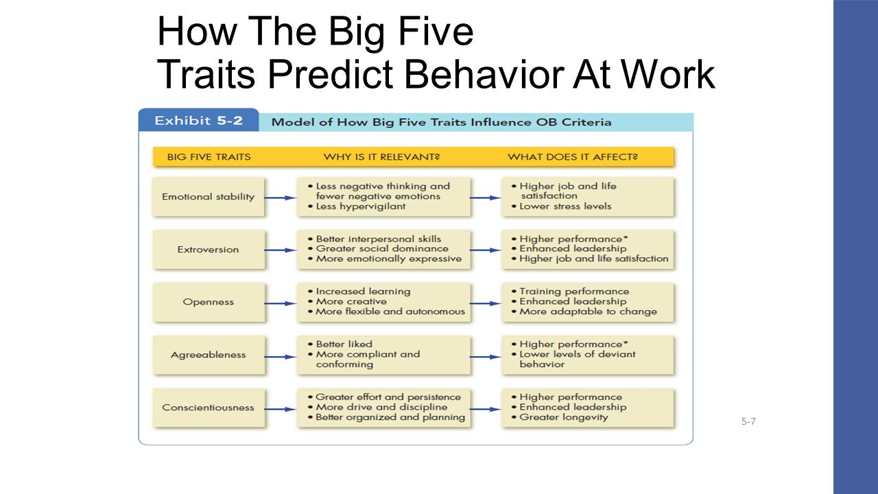
Taken from: Robbins & Judge (2017) Organisational Behaviour, 17th Ed

Slide 44
Important Note:
In reading about big five you may think some personalities are more desirable than others.
However this is a dangerous assumption as depends on social context within person is behaving.
Costa and McCare (2006) discuss the advantages and disadvadvantages of various scores e.g., High C is associated with academic and occupational achievement, on negative it may lead to annoying fastidiousness, compulsive neatness or workaholic behaviours.
CONTEXT MATTERS

Slide 45
Big Five + Performance
Overall mixed
Judge et al (2013) argue that weak overall relationship with job performance is due to facets masked by big factors.
Other research looking at the facets believe there is a higher level again called general factor personaliy GFP like spearmans general intelligence – loads onto Stability (E, C, low N) and Plasticity (O+E)
These two factors load onto a single factor – van der linden et al (2010) found that GFP had a significant relationship with performance indicators – like supervisor related performance). HOWEVER Too much of a good think (E, C) can impact task performance, OCB, and counterproductive work behaviour (le et al 2011)

Slide 46
Big Five + Performance
Findings indicate that personality-to-performance relationships at the facet level can be obscured if big five is examined alone.
At facet level, openness to experience displayed most variation of all big 5. Overall correlated moderately with job performance.
Different facets of each of big five have linkage with performance
Consciousnessious tends to predict overall job performance across a number of occupational settings. However exploring validity at face level, results are criterion dependent.
For other personality factors, their relationship with job performance depends on nature of the job,.
Extraversion seems to important for Leadership emergence (discuss later)

Slide 47
Other work-related aspects of personality
Achievement Motivation: The strength of an individual‘s desire to excel – to succeed at difficult tasks and to do them better than others
Morning persons and evening persons: Individuals who feel most energetic and alert early in the day vs. late in the day or at night
Self-Monitoring: reflects a person‘s ability to adjust his or her behavior to external, situational factors
Locus of Control: the extent to which a person feels able to control his or her own life
Notes:
Achievement motivation: the strength of an individual‘s desire to excel – to succeed at difficult tasks and to do them better than other people; people who are high in achivement motivation are attracted to tasks of moderate difficulty and people low in in achievement motivation are attracted to tasks that are extremely easy or extremely difficult. Are high-need achievers successful managers? PRO (tend to gain promotions more rapidly than those who are low in AM, at least in their early careers; they have a strong desire for feedback regarding their performance => strong perference for merit-based pay system vs. Seniority-based pay system, one in which pay and other rewards are based on performance); CONTRA (unwillingness to tackle difficult challenges interferes with their success; tend to be focused so much on their success that they are sometimes reluctant to delegate authority others, fail to get support from subordinates)
Individual differences in times of day suggests that individual differences in preferences for time are very important when it comes to job performance. Ideally, only individuals who are at their best late in the day should be assigned to night work.
Self-Monitoring: High self-monitoring individuals are sensitive to external cues and tend to behave differently in different situations. High self-monitors can present a very different appearance from the true self. In contrast, low self-monitors are not able to disguies their behaviors „what you see is what you get“. There is also evidence that high self-monitors are closely attuned to the behavior of others and conform more readily than do low self-monitors. Thus, they appear flexible. For example, high self-monitors should be especially good at changing their leadership behavior to fit subordinates with high or low experience, tasks with high or low structure, and so on.
Locus of Control: is concerend with a person‘s internal-external orientation and is measured by Rotter‘s locus of control instrument. People have personal conceptions about whether events are controlled primarily by themselves which indicates an internal orientation, or by outside forces, such as their social and physical environment, which indicates an external orientation. In general, externals are more extraverted in their interpersonal relationships and are more oriented toward the world around them. Internals tend to be more introverted and are more oriented toward their own feelings and ideas.
47

Slide 48
BIG 5, EYSENCK’S ETC.
Are examples of the Nomothetic approach
… emphasizes the identification of
universal personality traits …
uses objective questionnaires
describes personality in terms of traits,
trait clusters or personality types
view personality as composed of identifiable
elements

Slide 49
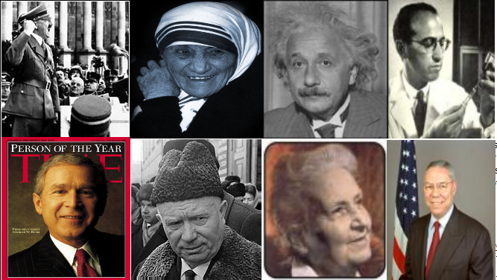
THE IDIOGRAPHIC APPROACH
Every individual has personal and unique qualities not shared by any other person in the world
Notes:
Individuals can be studied in two ways:
Nomothetically: As individual instances of general characteristics that are distributed in the population
Idiographically: As single and unique cases

Slide 50
THE IDEOGRAPHIC APPROACH: ASSUMPTIONS
Each individual is unique
Our behaviour patterns are influenced by experience, by conscious reflection and reasoning, not just by habit, instinct or heredity
We behave in accordance to the image we have of ourselves or self concept
Personality is open to change through new social interactions and experiences
Your self-understanding determines behaviour

Slide 51
PROJECTIVE TESTS
Projective tests
Based on the assumption that the test taker will transfer (“project”) unconscious conflicts and motives onto an ambiguous stimulus.
Examples include the Thematic Apperception Test and the Rorschach

Slide 52
THEMATIC APPERCEPTION TEST
Person is asked to tell a story about the “hero” in the picture
Another projective test
Based on Murray’s personality theory
People are distinguished by the needs that motivate their behaviour
Primary/Secondary Presses/Needs

Slide 53
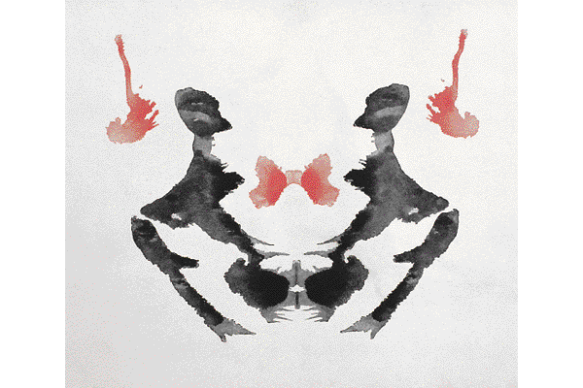
THE RORSCHACH INKBLOT TEST
Ambiguous stimuli
Person is asked to report what they see
This type of test is called projective
No clear image, so the things you see must be “projected” from inside yourself
Sample Rorschach Card

Slide 54
Idiographic approach and organisations
Not all people work in the environment where they are treated with positive regard
Can be complex and untidy in assessment
Absence of measures to use for this way
Is difficult for a lay person to assess
Doesn’t give a route to peoples mind
Thematic apperception tests can be used – but difficult for workplace

Slide 55
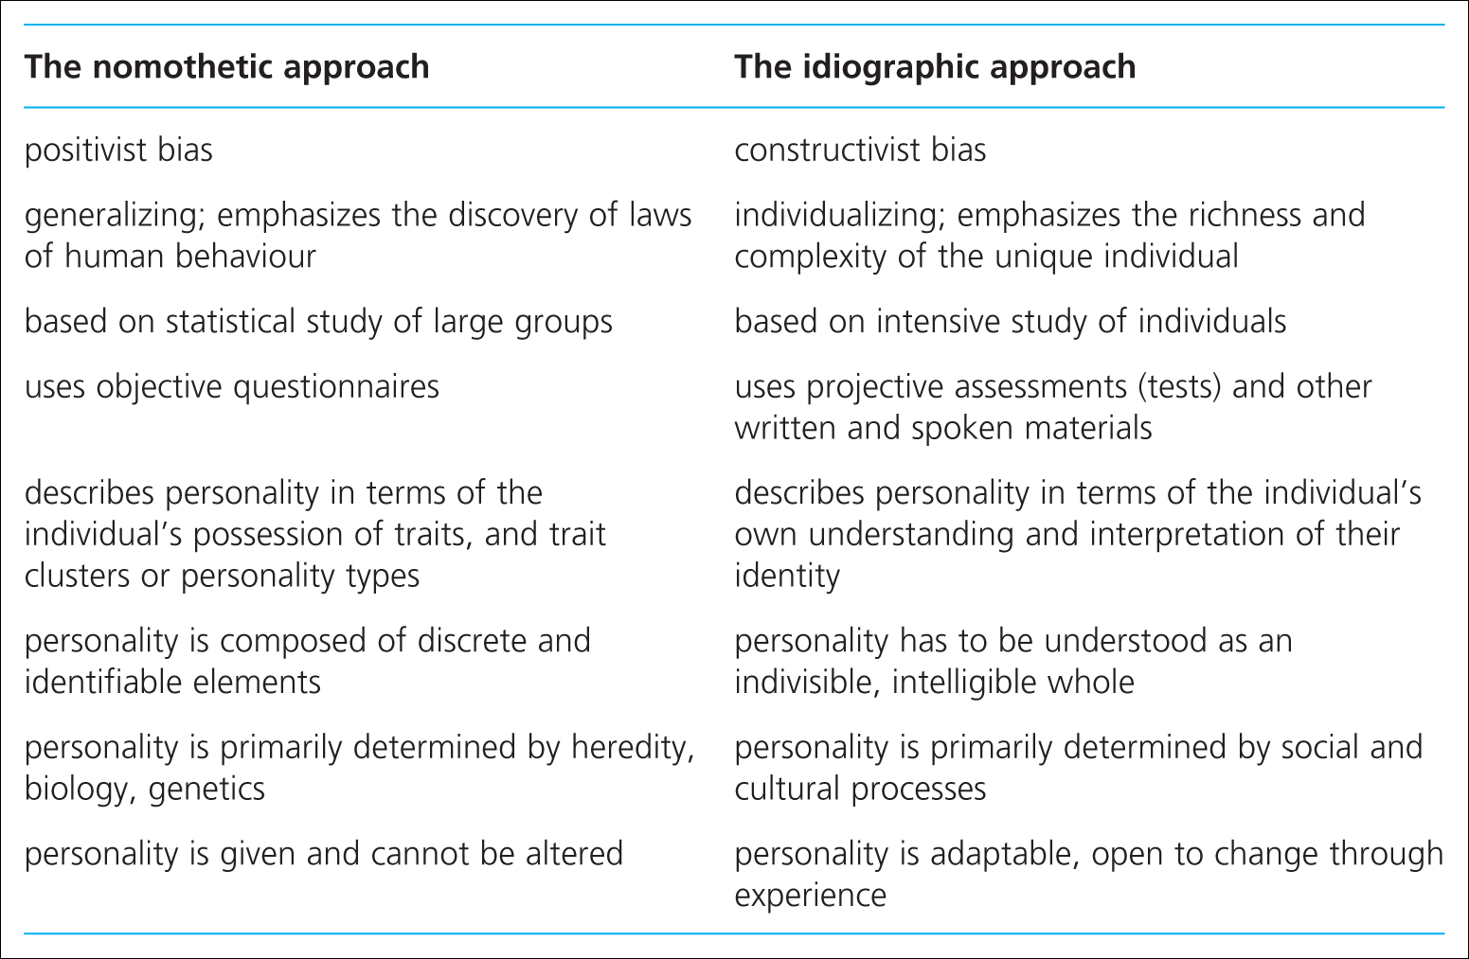
Table 6.7 Nomothetic versus idiographic

Slide 56
Dark Side of Personality
Personality can shape how others see us, and can concern reputation
How we get along while we get ahead influences our reputation, and can impact our future career/directions (see HBR article on Brightspace)
Most research focuses on the positive side of personality i.e. “the bright side”
Last few years rapid development of research examining “the dark side” examining how this can impact workplace in terms of effectiveness, relationship and management derailment (MHoansi, 2007)
Hogan Development Survey (HDS) measures dysfunctional styles that interfere with leadership and interpersonal relationships, especially at work (Hogan & Hogan, 1997)
3 broad factors (Dark Triad)

Slide 57
Dark Side of Personality
Only 11% of the population do not have any noticeable dark side characteristics (although we might not know it, seeing ourselves as charming instead of manipulative)
Often linked to having low emotional adjustment.
Individuals with low emotional adjustment often show their dark side more in work – seen as immature and unable to manage emotions.
HOWEVER how behaviour manifests depends on personality
Example: if a High E has low emotional adjustment but very high confidence and charm, they will express behaviours outwardly but lack maturity to manage them – seen as arrogant and manipulative by others
A high sense of belief is coupled with narcissistic tendencies
If someone is more Introverted, takes pride in themselves for being shrewd, focused, politically alert, when threatened they may become distrustful and passive aggressive.

Slide 58
Bright Side | Dark Side
Excitable, enthusiastic, quick to respond | Moody, easily annoyed, hard to please emotionally volatile
Sceptical, shrewd | Distrustful, Cynical, sensitive to criticism, focused on negative
Cautious, careful | Unassertive, resistant to change, risk-averse, slow to make decisions
Reserved, independent | Aloof, detached, indifferent to the feelings of others, uncommunicative
Leisurely, focused | Overly co-operative, but privately irritable, stubborn, unco-op, passive aggressive
Bold, confident | Overly self-confident, arrogant, inflated feelings of self-worth & entitilement
Mischievous, charming | Manipulative, risk-taking, easily bored, limit-testing, excitement seeking
Colourful, lively, expressive | Dramatic, attention-seeking, interruptive, poor listening skills
Imaginative, creative | Inappropriate creative ideas, thinking & acting in unusual/eccentric ways
Diligent, meticulous | Precise, hard to please, perfectionist, tends to micromanage
Dutiful, eager to please | Reluctant to act independently or against popular opinion
(Hogan & Hogan, 2009)

Slide 59
Debate: Does it change?
Depends on how you define Personality. . .
Most common view is Trait perspective of Personality – see’s it as stable and enduring
BUT
Roberts et al (2006) conducted meta-analysis of 50,000 participants from 92 different studies.
As people grew older emotional stability, conscientiousness all increased (especially between ages of 20 and 40)
Rantenan et al (2007) did meta analysis of big five studies using SEM and found increase between ages of 32 and 42 in E, O, A and C, while N fell between 33 and 42.
E and N change dlecreased over time in male sample than female sample.

Slide 60

Psychometrics
“the systematic testing, measurement, and assessment of intelligence, aptitudes and personality”

Slide 61

What are Psychometric Tests?
‘A carefully chosen, systematic and standardised procedure for evolving a sample of responses from candidates which can be used to assess one of more of their psychological characteristics with those of a representative sample of an appropriate population’ (Smith & Robertson, 1986)
Umbrella term for aptitude and personality tests
The purpose is to obtain relevant information which will give an indication of a candidate’s future performance and suitability for the position.
Because they are standardised, psychometric tests offer a convenient method of comparing candidates’ results.
Used correctly they provide some valid and constructive information

Slide 62

Essential Features
Validity – measure what they are meant to
Reliability – results are consistent
Standardisation – same for every candidate
Objectivity – fair and free from bias assessment & results
Differentiation – differentiate between people to show differences

Slide 63
Use of psychometrics
Assessment for suitability for promotion
Assessment for redeployment purposes
Evaluation of training potential
Team and leadership development
Career counselling and development
Graduate recruitment
Vocational guidance
Redundancy counselling

Slide 64
Advantages
Test results numerical, allowing direct comparison of candidates on same criterion
Provide hard data that can be evaluated for their predictive usefulness in later years
Provide explicit and specific results unlike interviews and references which can be value
Tests measures substance rather than image
Tests are ‘scientific’, empirically based with a grounding in theory
Provide a conceptual language to users
Empirical data from tests provide objective evidence to justify decisions
Provide insights and explanations for behaviour.

Slide 65
Disadvantages
Issues of faking
Some people lack sufficient self-insight to give accurate responses
Unreliable - temporary factors (eg illness) can affect results
Invalid – many do not measure what they say they measure
Irrelevant – many do not measure qualities that are relevant to a specific organisation
Require minimum literacy and a grasp of American jargon
Good norms do not exist for most populations
Unfair to anyone who is not a white, middle-class male American
Freedom of information legislation opens ‘objective’ date to greater scope for challenge than value, unrecorded interview data
Firms tend to use the same tests so that practice effects and knowledge of desirable answers can destroy their value

Slide 66
Popularity of different selection methods (zibarras, and woods, 2010)
Selection Method | Percentage of organisations using method
CV | 85
References | 72
Structured interview | 69
Application form | 60
Trial period on the job | 58
Unstructured interview | 42
Aptitude/ability test | 39
Numeracy/literacy test | 28
Biodata | 27
Criminal check | 27
Personality questionnaire | 19
Work sample | 17
Drug test/medical check | 16
Group exercise | 15

Slide 67
Validity coefficients for selection methods (Robertson and Smith, 2005)
METHODS | VALIDITY COEFFICIENT
Perfect selection | 1.0
Intelligence and integrity tests | 0.65
Intelligence tests and structured interviews | 0.63
Intelligence tests and work sampling | 0.60
Work sampling | 0.54
Intelligence tests | 0.51
Structured interviews | 0.51
Integrity tests | 0.41
Personality assessments | 0.40
Assessment centres | 0.37
Biodata | 0.35
References | 0.26
Years of job experiences | 0.18
Years of education | 0.10
Graphology | 0.02
Selection with a pin | 0.00

Slide 68

Personality Testing
Psychologists define personality as:
“ The particular pattern of behaviour and thinking that prevails across time and contexts, and differentiates one person from another”
Personality Trait is assumed to be some enduring characteristic that is relatively constant.
Trait theories specifically focus on explaining more permanent personality characteristics that differentiate one person from another

Slide 69
Common Types of Personality Tests
Myers Briggs Type Indicator (MBTI)
[Extraversion – Introversion] [Sensing – Intuition] [Thinking – Feeling] [Judging – Perceiving]
Cattell’s 16 PF – 16 Dimensions
E.g. [cool-warm] [ submissive – dominant] [relaxed – tense]
Occupational Personality Questionnaire
Belbin Team Role Self-Perception Inventory
The Big 5 (Costa & McCrae, 1985)

Slide 70
Personality Testing
It is important to remember that low, average, and high scores on a personality trait questionnaire are neither intrinsically good nor bad.
A particular level on any trait will probably be neutral or irrelevant for most activities, helpful for accomplishing some things, and detrimental for accomplishing others.
As with any personality questionnaire, scores and descriptions can only approximate your actual personality.
Whilst all of this may be true, in the real world test results will have a significant influence on your chances of being rejected.

Slide 71
Examples: Personality Tests
Likert
I lose my temper over minor incidents.
a) True b) In Between c) False
I like giving practical demonstrations in front of others.
a) True b) Uncertain c) False
I double-check for errors when I perform calculations.
a) True b) Sometimes c) False

Slide 72
Examples: Personality Tests
I like working to strict time deadlines
a) strongly agree
b) agree
c) unsure
d) disagree
e) strongly agree
On TV, drama series are more interesting than factual series
a) strongly agree
b) agree
c) unsure
d) disagree
e) strongly agree

Slide 73
Examples: Personality Tests
Ipsative (i.e. forced choice)
Would you rather work with people who are:
a) generous b) hard-working
Do you feel that it is best:
a) to be too assertive b) not to be sufficiently assertive
Which word appeals to you most in each of the following pairs?
a) effective b) pleasant c) loyal d) ambitious

Slide 74
Examples: Personality Tests
Which of the following is most, and which is least, appropriate in describing your personality?
1. (a) kind (b) influential (c) respectful (d) inventive
2. (a) refined (b) adventurous (c) tactful (d) content

Slide 75
Choosing the Test
Availability
Appropriateness
Evidence of Reliability
Evidence of Validity
Face/Faith Validity
Content
Construct
Criterion
Evidence of the use of test elsewhere
Sensitive
Prevents unfair Discrimination

Slide 76
Is testing appropriate?
Depends on:
Nature of the job
Characteristics of the Ideal Candidate
Review of other possible selection methods
Conditions of Use:
Should be used in conjunction with other methods
Consider cost
Recognise Limitations
Use Reputable suppliers
Respect the individual
(See Palmer’s 2002 article – “very testing testing”)

Slide 77
Professional Issues: Testing (see www.psychtesting.org.uk)
Technical standards
Restricting use to situations of proven worth
Using specially trained staff
Explaining the reasons for testing
Giving information in advance of testing
Monitoring, evaluating & improving
The testing environment
Accurate scoring
Interpretation
Giving feedback
Availability of records of testing
Appropriate use of records of testing

Slide 78
Controversial Issues & Possible Problems
Assumptions that personality:
Is measurable
Remains stable over time
Different jobs suit different personalities
Short test to determines suitability for the job
Problems
Predictive Validity
Distortion & Faking (Social Desirability)
Barnum Effect
Ethical Issues

Slide 79

Evaluating R & S: An art in the Search of Science?

Slide 80
Practicality
Is your selection method fair?
Cost
Convenience
Time available
Who is involved?
Attitudes of candidates and employers also relevant here

Slide 81
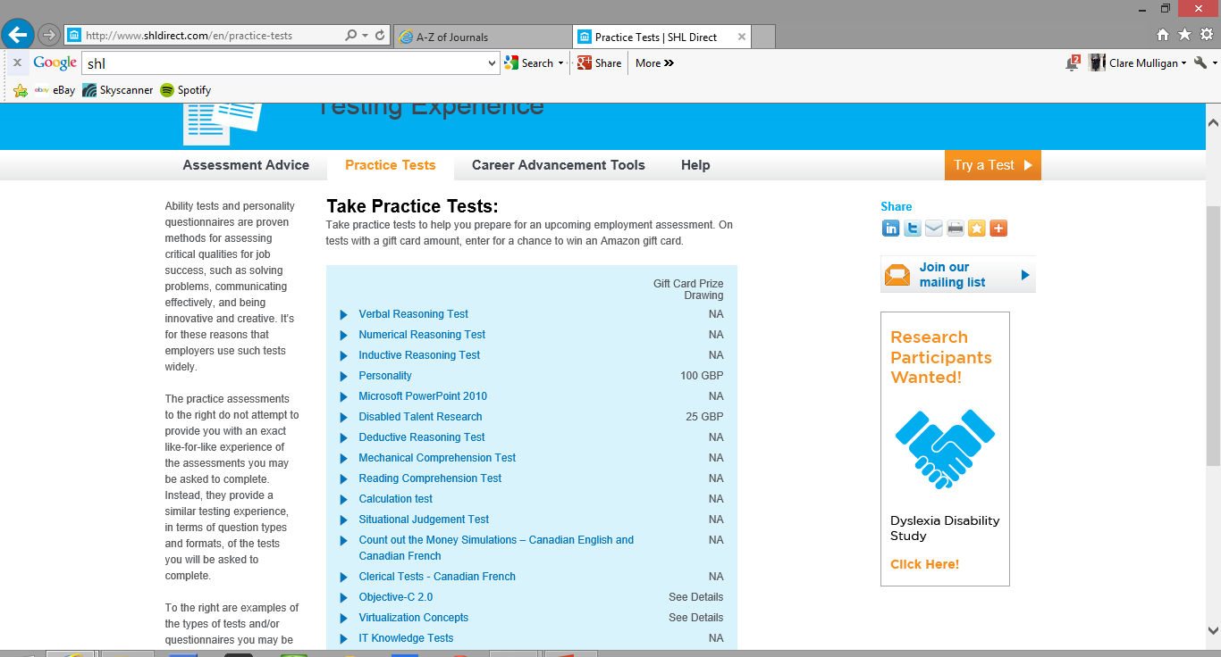
http://www.shldirect.com/en/practice-tests

Slide 82

Thank you for listening

